Slide 1
2019 SALES DASHBOARD

Slide 2
INTRODUCTION
Hello And Welcome. In Today’s Presentation, I Am Excited To Take You Through This 2019 Sales Dataset.
I Am Really Excited To Be Doing This Presentation As It Has Given Me The Opportunity To Dive Into, And Gain Insightful Information About This Special Project

Slide 3
ABOUT dataset
Hola, My Name Is Quansah Abaidoo Meshach, A Data Analyst And I Am Here Today To Take Us Through This Wonderful Presentation.
This dataset comprised of 4 files for four different months starting January 2019 through to April 2019 and management is asking us to work out somethings with this data to help make informed decisions so yes.
Thank you

Slide 4
PROCESS
I am excited to state that, I took the necessary steps to ensure this process has been cleaned properly before finally arriving at the final result.
Firstly, I got this dataset from Kaggle and downloaded it.
Secondly, I extracted the file and named it 2019 sales dataset on my computer and since it had a number of same files, I decided to then save everything I extracted into one folder so I can just combine the whole CSV file in power bi.
Thirdly, after saving the whole file in one folder, about 4 csv files I extracted, into one folder, I named it again as 2019 sales data set.
I then opened power Bi to start work. So I exported the whole folder containing the files from my desktop to power bi and then chose the combine and transform data option.
After choosing to combine all the files in the folder as one, I needed to do a little transforming before anything else in order to make my visualization work easy. So I decided to clean the data, I checked for duplicates, null or blank values and removed then. I then had to standardize the date column. After which I decided to split the purchase address column into purchase address street, city and address.

Slide 5
OBJECTIVE
To uncover valuable and unexpected hidden insights from the data, answering business questions and providing strategic recommendations

Slide 6
BUSINESS QUESTIONS/ KPIs
Manager now wants to have some insights into this dataset and has prepared some valuable questions we had to answer as follows;
What is our total sales?
Kindly find the total quantity of goods ordered.
What are the least or bottom 5 ordered products?
What are the most or top 5 ordered products?
Find the sum of the total quantity ordered by months.
which day does the business receives more orders?
Which city contributed the highest sales?
The top 5 and bottom 5 products by sales.
What is the total sales by month?
What is the total sales and total quantity ordered by month?

Slide 7
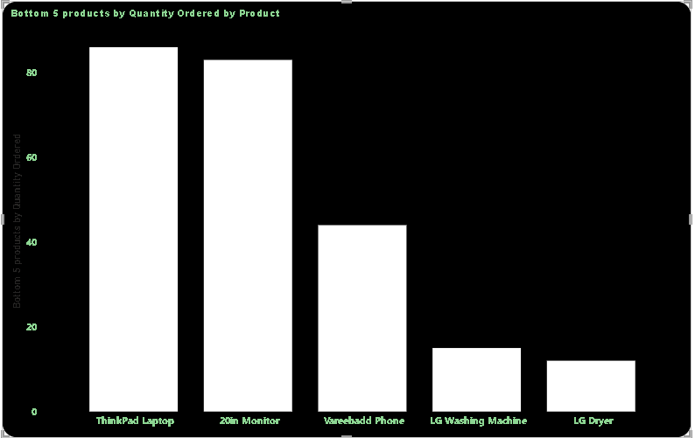
BOTTOM 5 PRODUCTS BY QUANTITY ORDERED
At 86, ThinkPad Laptop had the highest Bottom 5 products by Quantity Ordered and was 616.67% higher than LG Dryer, which had the lowest Bottom 5 products by Quantity Ordered at 12.
ThinkPad Laptop accounted for 35.83% of Bottom 5 products by Quantity Ordered.﻿
Across all 5 Product, Bottom 5 products by Quantity Ordered ranged from 12 to 86

Slide 8
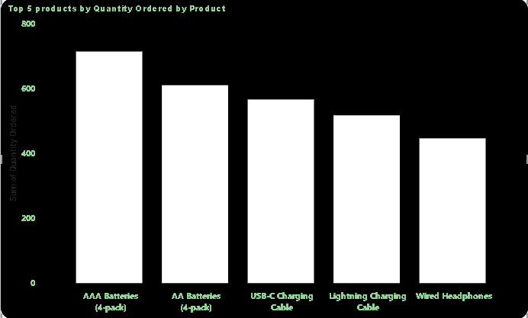
TOP 5 PRODUCTS BY QUANTITY ORDERED
At 715, AAA Batteries (4-pack) had the highest Sum of Quantity Ordered and was 59.96% higher than Wired Headphones, which had the lowest Sum of Quantity Ordered at 447.
﻿AAA Batteries (4-pack) accounted for 25.02% of Sum of Quantity Ordered.﻿
Across all 5 Product, Sum of Quantity Ordered ranged from 447 to 715

Slide 9
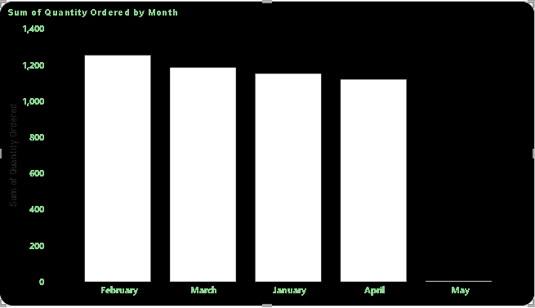
SUM OF QUANTITY BY MONTH
At 1254, February had the highest Sum of Quantity Ordered and was 125,300.00% higher than May, which had the lowest Sum of Quantity Ordered at 1.
February accounted for 26.61% of Sum of Quantity Ordered.﻿
Across all 5 Month, Sum of Quantity Ordered ranged from 1 to 1254

Slide 10
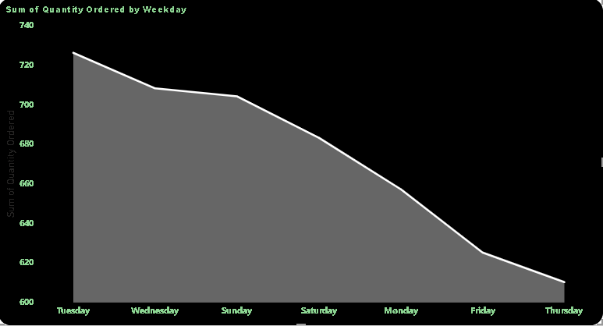
QUANTITY ORDERED BY WEEKDAY
At 726, Tuesday had the highest Sum of Quantity Ordered and was 19.02% higher than Thursday, which had the lowest Sum of Quantity Ordered at 610.
Tuesday accounted for 15.40% of Sum of Quantity Ordered.﻿
Across all 7 Weekday, Sum of Quantity Ordered ranged from 610 to 726

Slide 11
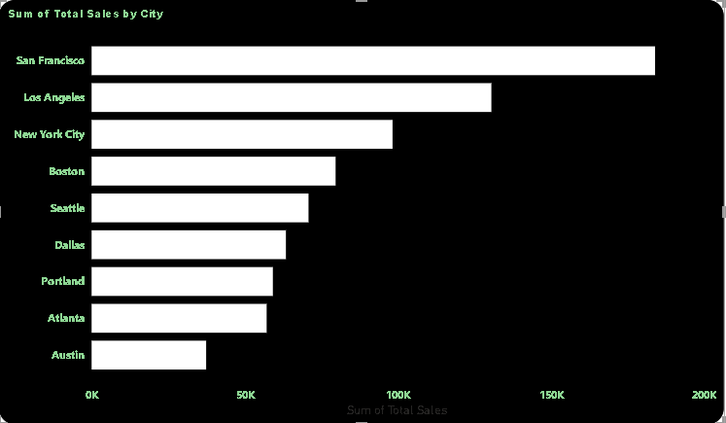
TOTAL SALES BY CITY
At 183,981.00, San Francisco had the highest Sum of Total Sales and was 391.94% higher than Austin, which had the lowest Sum of Total Sales at 37,399.20.
﻿ San Francisco accounted for 23.57% of Sum of Total Sales.
﻿Across all 9 City, Sum of Total Sales ranged from 37,399.20 to 183,981.00.

Slide 12
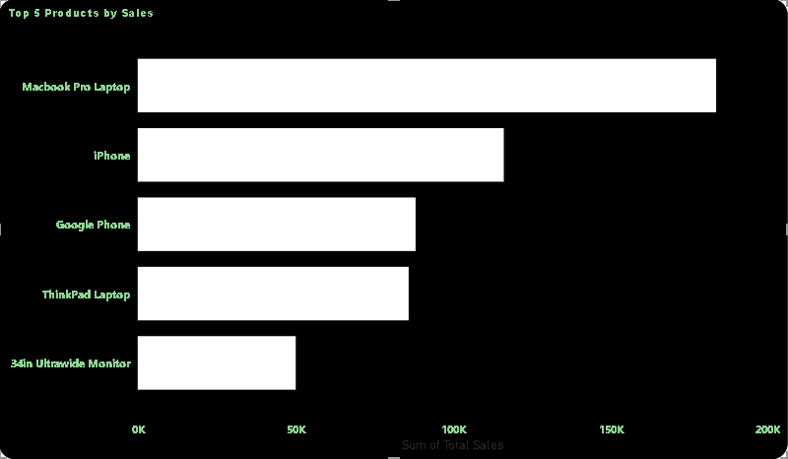
TOP 5 PRODUCTS BY SALES
At 183600, Macbook Pro Laptop had the highest Sum of Total Sales and was 266.03% higher than 34in Ultrawide Monitor, which had the lowest Sum of Total Sales at 50160.
Macbook Pro Laptop accounted for 35.03% of Sum of Total Sales.
﻿Across all 5 Product, Sum of Total Sales ranged from 50160 to 183600.

Slide 13
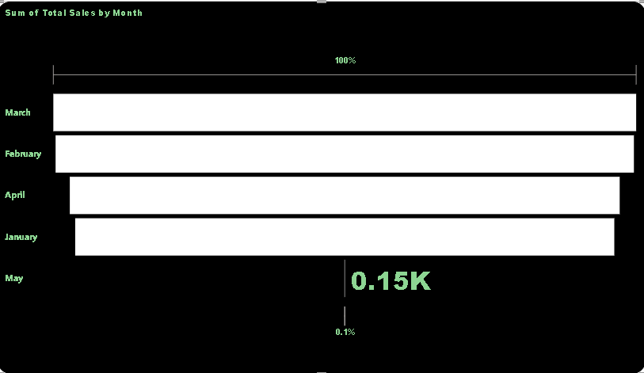
SALES BY MONTH
This chart shows that during the four months period in 2019 the majority of sales happened in March, followed by February then April and finally January with the lowest sales. It can also be deduced that there was a small data from may.

Slide 14
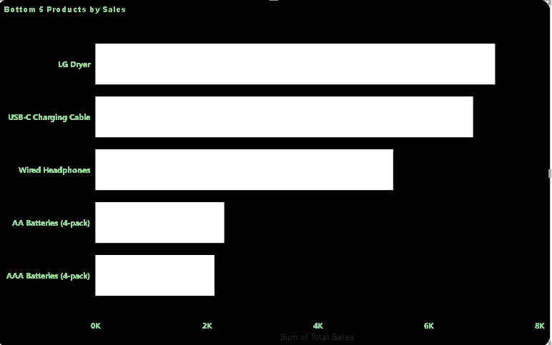
BOTTOM 5 PRODUCTS BY SALES
Bottom 5 products by sales
At 7200, LG Dryer had the highest Sum of Total Sales and was 235.66% higher than AAA Batteries (4-pack), which had the lowest Sum of Total Sales at 2145.
LG Dryer accounted for 30.21% of Sum of Total Sales.
﻿Across all 5 Product, Sum of Total Sales ranged from 2145 to 7200.

Slide 15
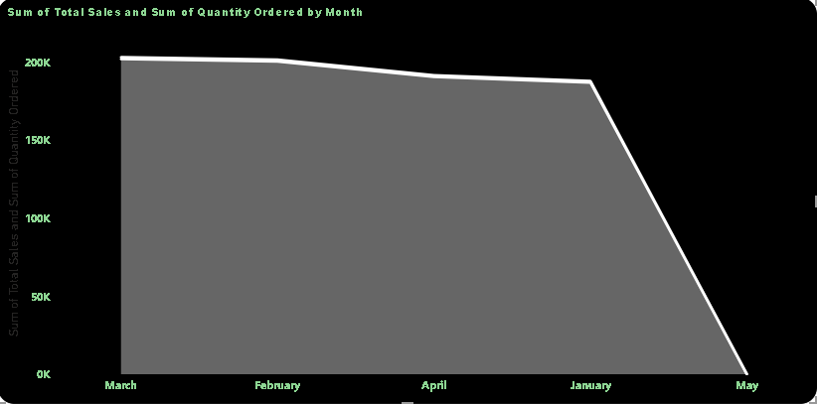
TOTAL SALES AND QUANTITY ORDERED BY MONTH
At 202,110.60, March had the highest Sum of Total Sales and was 134,640.40% higher than May, which had the lowest Sum of Total Sales at 150.
﻿Sum of Total Sales and total Sum of Quantity Ordered are positively correlated with each other.﻿
March accounted for 25.90% of Sum of Total Sales.
Sum of Total Sales and Sum of Quantity Ordered diverged the most when the Month was March, when Sum of Total Sales were 200,924.60 higher than Sum of Quantity Ordered.

Slide 16
RECOMMENDATION
The data highlights the ThinkPad Laptop as a strong performer within the Bottom 5 products, suggesting that targeted marketing and inventory strategies could further capitalize on its success. At the same time, it is crucial to address the factors affecting the performance of lower-ordered products like the LG Dryer to achieve a more balanced product portfolio.
The strong performance of AAA Batteries (4-pack) should be leveraged through enhanced marketing and inventory strategies. Addressing the performance of Wired Headphones and adjusting inventory levels based on demand will help in optimizing overall product sales and achieving a balanced portfolio.
The strong performance in February should be leveraged to enhance overall sales strategies, while addressing the factors contributing to lower order volumes in months like May. By optimizing inventory and marketing strategies based on monthly performance trends, you can improve sales consistency and drive better results across all months.
By leveraging the success of high-order days like Tuesday and addressing the factors contributing to lower order volumes on days like Thursday, you can optimize overall sales and inventory management. Implementing targeted promotions and adjusting inventory based on weekday performance will help enhance sales consistency throughout the week.
By leveraging the strong performance in San Francisco and addressing the factors affecting lower sales in cities like Austin, you can optimize sales strategies and resource allocation. Tailoring marketing efforts and continuously monitoring sales trends will help enhance performance across all cities and drive overall growth.

Slide 17
RECOMMENDATION II
By capitalizing on the strong performance of the Macbook Pro Laptop and addressing the factors contributing to the lower sales of products like the 34in Ultrawide Monitor, you can enhance overall sales performance. Optimizing inventory, marketing strategies, and product positioning will help drive growth and improve sales across all products.
Based on the sales data from the four-month period in 2019, where March experienced the highest sales, followed by February, April, and January with the lowest sales, it is recommended to focus marketing and inventory efforts on the peak months of March and February. Consider analyzing the factors contributing to the strong performance in these months and replicate similar strategies. Additionally, investigate the minimal data from May to determine if it indicates an opportunity for growth or requires further attention.
Given that the LG Dryer led the Bottom 5 products with a total sales figure of $7,200, significantly outperforming the AAA Batteries (4-pack) at $2,145, it is recommended to focus on optimizing the sales strategy for high-performing products like the LG Dryer. Leverage its success through targeted promotions and expanded visibility. For the lower-performing products, such as the AAA Batteries (4-pack), investigate factors contributing to their lower sales and implement strategies to boost their performance, such as adjusting pricing, enhancing marketing efforts, or reevaluating their market positioning.
Since March achieved the highest total sales of $202,110.60 and exhibited a strong positive correlation with the quantity ordered, it is advisable to capitalize on the strategies that contributed to March's success. Analyze and replicate these effective tactics to boost sales in other months. Additionally, address the disparity in March, where total sales exceeded quantity ordered by $200,924.60, to understand and balance this divergence. For months with lower sales, like May, implement targeted marketing and sales strategies to enhance performance and better align with the successful practices observed in March.

Slide 18
THANK YOU MESHACH ABAIDOO QUANSAH

